Slide 1

Financial Modeling Project: Charles Adams Ahmet Aytekin Yangyang Li Mohamed Seifeldin

Slide 2
Introduction
Founded in 1903 by Henry Ford
Ford is an Automobile manufacturing company that is based in the United States.
The company and its founder Henry Ford created the Model T car popularized worldwide.
They currently manufacture sedans, SUVs, EVs, and trucks with a production and supply-chain system that spans the globe.
Plans on investing more in EVs

Slide 3
Operations
The Automotive Segment (About 95% Revenue)
Ford
The Mobility Segment (About 5% Revenue)
Argo AI
Lincoln
Autonomous Vehicles
R&D

Slide 4
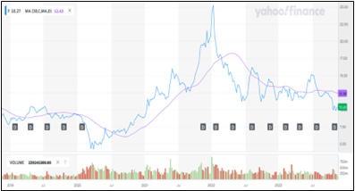
Stock Price Trends
Stock Trend: General downward trend observed with some variability.

Slide 5
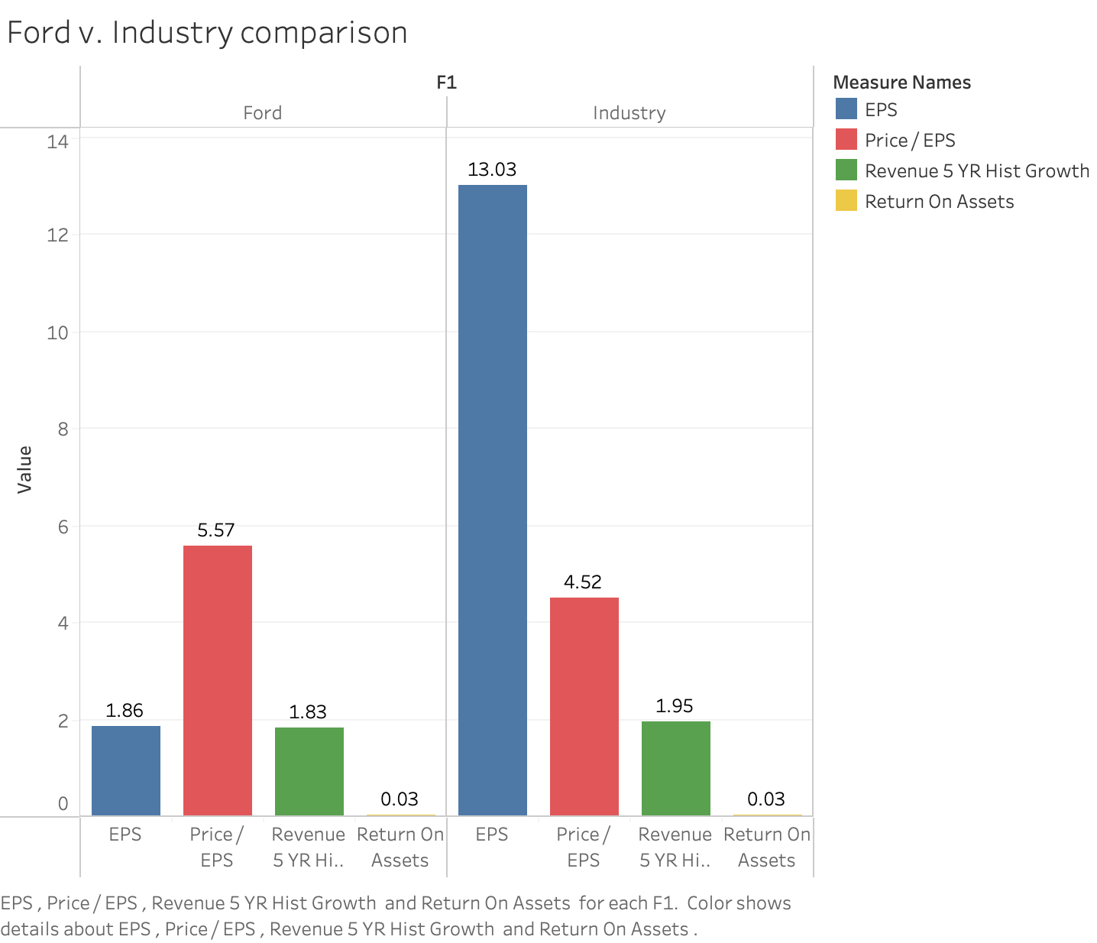
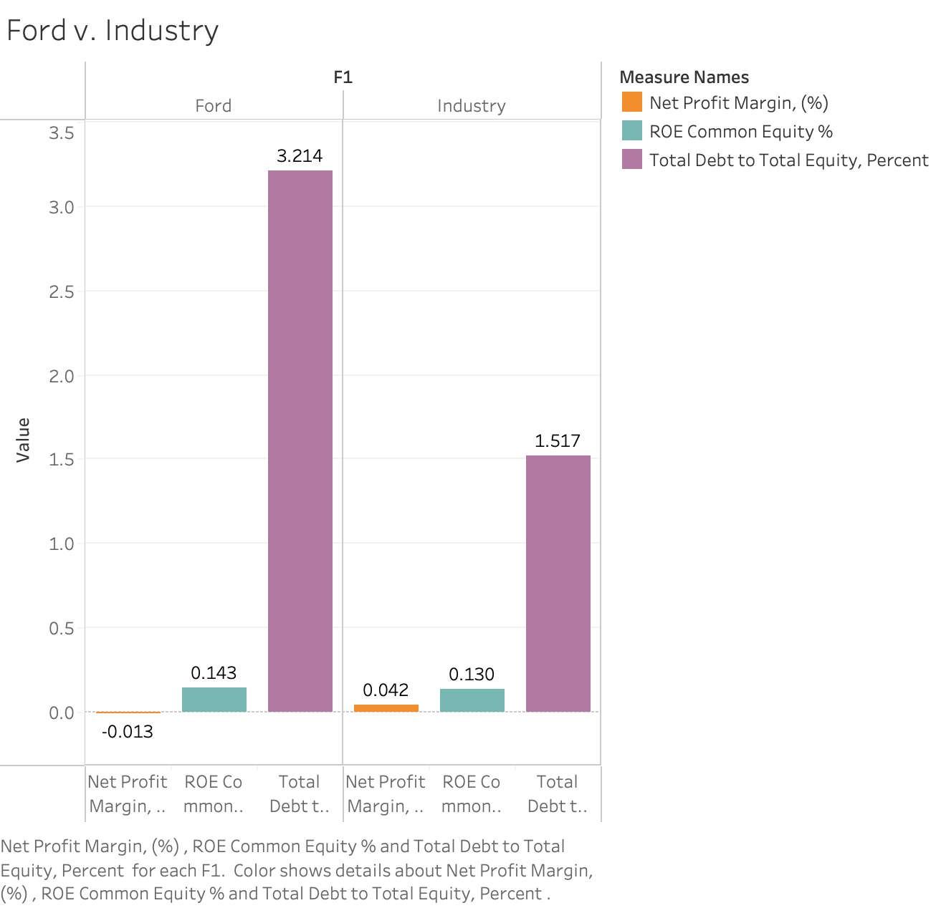
Ford v. Industry Comparison

Slide 6
Relative Valuation
Current P/E: 6.95
FY2022 EPS: $ -0.49
FY2022 Revenue: $158B

Slide 7
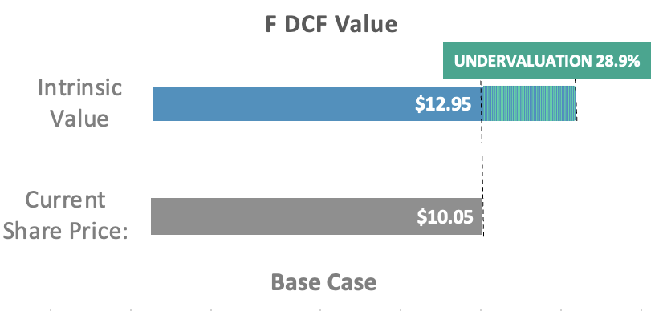
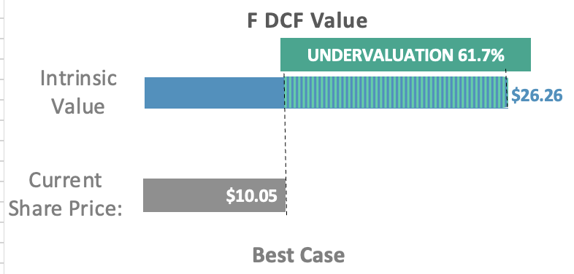
DCF Analysis
Estimated Value of F is $12.95. Compared to current market price of $10.05→ undervalued by 28.9%
Estimated Value of F is $26.26. Compared to current market price of $10.05→ undervalued by 67.1%
Terminal EBITDA Multiple
Influenced by current market
Reflects market valuation of peers
Yield conservative values
Terminal FCF Growth Rate
Based on long-term intrinsic growth
Assumes indefinite constant FCF growth
Higher valuations with positive growth outlook
This DCF valuation model was updated on Nov 8, 2023.

Slide 8
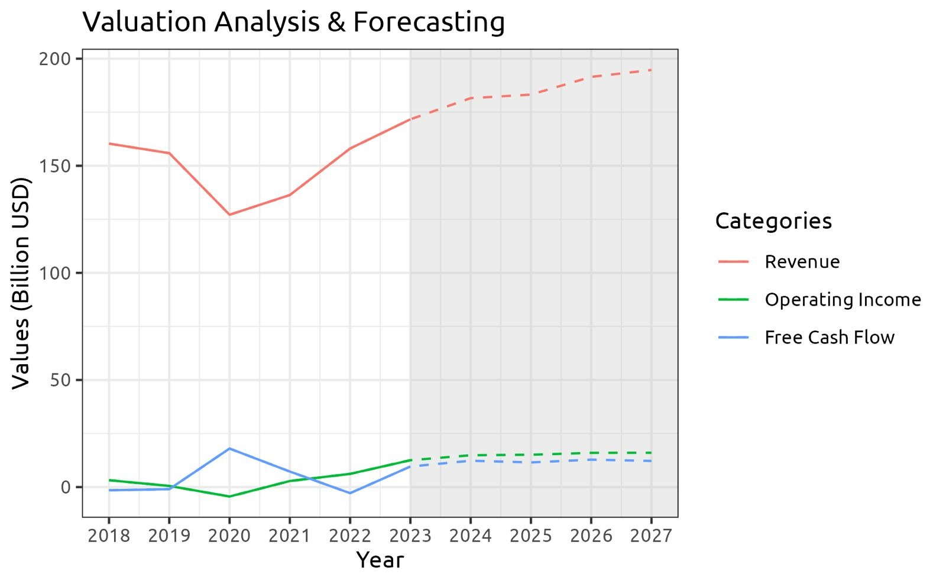
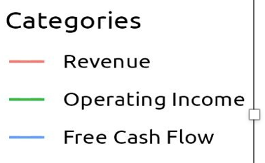
DCF-Financials Analysis
Revenue
160B → 194B
Historical Financials
Forecasted Financials
Revenue on upward trajectory suggests positive market demand & business strategies.
Operating income recovery → Improved operations and cost management.
Projected FCF stabilization and growth indicate solid cash management and reinvestment potential.
Past income and FCF volatility align with economic and industry challenges now being mitigated.

Slide 9

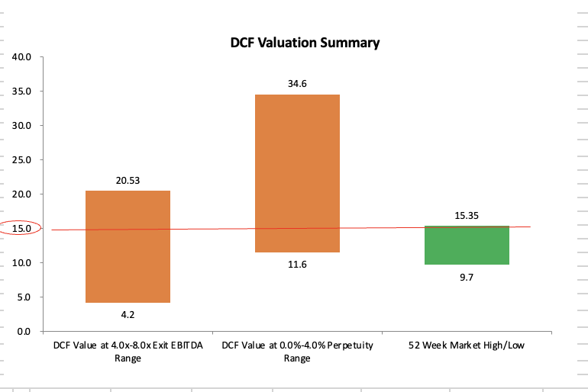
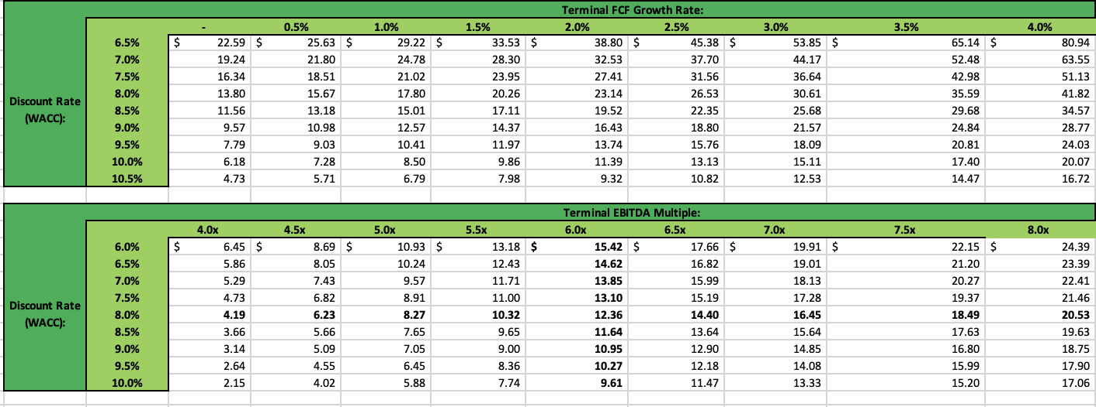
DCF Sensitivity Analysis
Sensitivity Trend Analysis
Terminal FCF growth increases share price, more so with lower WACC
DCF sensitivity to growth expectations is pronounced in low-interest scenarios
Ford's stock may be undervalued if higher FCF growth is maintained
Rising EBITDA multiples indicate optimism about Ford's profitability.
Conclusion
DCF valuations above 52-week high suggest potential undervaluation of Ford's stock.

Slide 10

Vunerable to several ESG risks;
Climate Change – Carbon Emission
Challenge in reducing carbon footprint
Regulatory penalties if cannot meet standards
Transparency to Shareholders for Better Governance
Social risks;
Labor rights – Mistreated Temporary Employees Before
Could tackle the problem with policies
ESG Risks

Slide 11
Recommendations
Ford is recommended as buy
Introduction of new and cheaper EV models will be beneficial to Ford
Share price expected to grow by up to 2$ in the next 24 months
Intrinsic value significantly exceeds its current market price
Share price is undervalued
DCF model projections suggest strong performance in the future

Slide 12
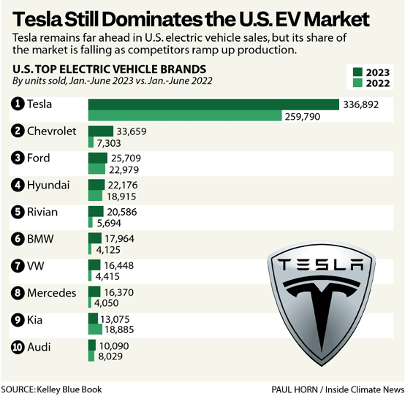
Industry Overview
Experienced challenges during COVID-19 pandemic.
UAW ends strike after almost 2 months
Major labor and pay changes to the industry
Changes in EV production in the US and abroad
Major changes in the US EV market but no increase in sales

Slide 13
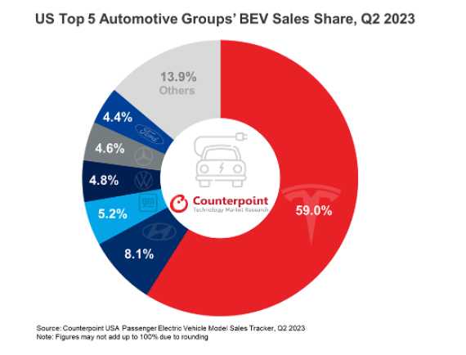
Market Performance
Tesla: Leads U.S. BEV market with 59% share in Q2 2023.
Ford: Has a 4.6% BEV market share.
Positioning: Tesla is established as the BEV leader; Ford is a smaller contender.
Challenges: Ford is tasked with growing its BEV footprint.
Factors: Market share gaps may stem from product variety, tech, brand strength, and output differences.

